Slide 1
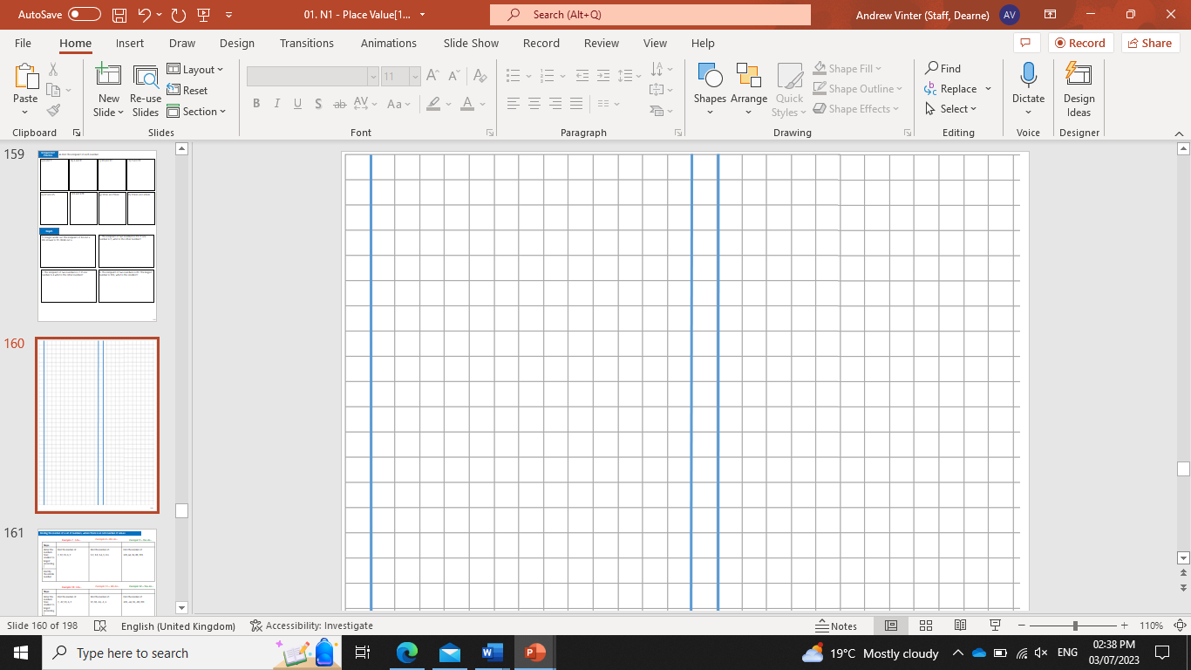
Subtopic N3.15 - Decimal Multiplication: Decimal by an Integer
LEARNING OUTCOME: To understand how to multiply decimals by integers
Objectives:
Keywords:
Multiply
Integer
Decimal
To be able to use formal methods of multiplication.
To be able to apply formal methods of multiplication to decimals.
To be able to use the knowledge of multiplication to solve problems in context.
Introduction – read and annotate:
When you multiply a decimal by an integer, it works just like multiplying whole numbers—you just
need to place the decimal point correctly. You will use your knowledge of multiplying by 10, 100, and
1,000 to make the numbers easier to work with. Correct place value is key to getting accurate answers.
Multiplying a decimal by a one-digit integer
Example 1 – I do…
Example 2 – We do…
Example 3 – You do…
Steps
2
4.8
2.1
17
16.8
5.1
117
196.8
35.1
Independent Practice
Question 1. Work out the following:
1.2
1.6
4

Slide 2
2.4
1.6
9.6
4.8
9.6
10.6
21.9
6.4
14.5
25.2
66.5
53.6
34.2
38.4
97.2

Slide 3
225
369.6
519.6
1294.8
11193.3
636
Question 2. Work out the following:
2.52
7.89
15.42
25.12
37.65
3.04
57.72
86.66
147.78

Slide 4
437.36
27.24
84.28
1.149
8.652
24.873
48.115
29.648
34.671
Multiplying a decimal by an integer with two or more digits
Example 4 – I do…
Example 5– We do…
Example 6 – You do…
Steps
1.149
8.652
24.873
Independent Practice
Question 3. Work out the following:
16.12
42.67
287.5

Slide 5
68.88
222.25
283.05
2667.2
219.96
15.96
15.96
730.17
474.15
899.36
282.9
1189.1
3018.6
349.6
728.4

Slide 6
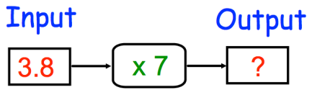
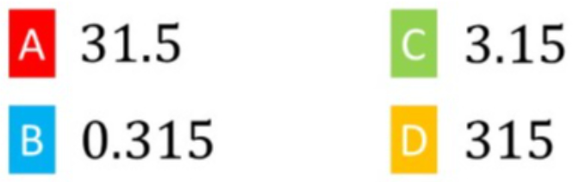
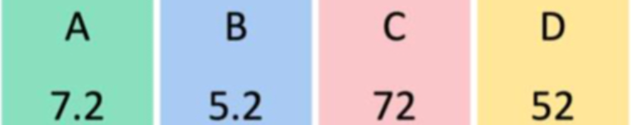
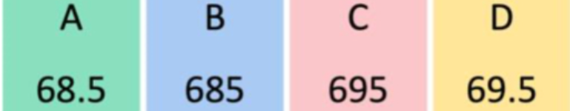
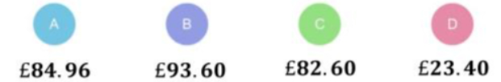
Question 4 | Question 5
Regan is paid £6.70 per hour. He works 8 hours in a week. Work out how much Regan should be paid. | Calculate the output
Question 6 | Question 7
A bottle of cola costs £1.29 Calculate the total cost of 6 bottles of cola. | A class are going on a trip to a windmill. The trip costs £3.70 each and there are 26 students. How much money should be collected?
£53.60
26.6
£7.74
£96.20
Skills Check
Calculate 0.63 x 5
Calculate 1.8 x 40
Calculate 13.7 x 50
Fredrik is paid £7.89 per hour. He works 12 hours in a week. Work out how much Fredrik should be paid.

